Slide 1

The weighted Poisson Process
By: Justin Chen

Slide 2
Introduction
-The classical Poisson process assumes equidispersion (equal mean and variance)
-however, when we look at the nuances of empirical data, one can see how this assumption quickly falls apart
-Thus, we introduce a new class of Poisson processes to model such data. The weighted Poisson Process

Slide 3

Main Ideas
1. To quickly review what a Poisson distribution and process is, and the corresponding limitations
2. Introduce the idea of a weighted Poisson distribution, including the prior work done
3. The methodology for constructing the weighted Poisson process. As well as deriving the dispersion of such models
4. Proposing two examples and the corresponding derivation of the dispersion. We hope to derive a model for underdispersion and overdispersion
5. Conducting a simulation study to affirm our derivations

Slide 4
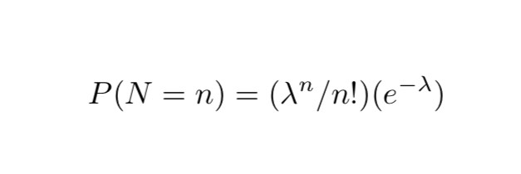
Homogenous Poisson distribution
-The homogenous Poisson distribution has the following formula:
N=Number of occurrences
λ= mean number of events
This gives us a discrete distribution since the events are countable (n∈{0,1,2,….}).

Slide 5

Complete independence
Say we have a collection of disjoint subregions that exist in the space we defined. The number of points in each subregion is independent of the other subregions. Meaning that the process is completely random. The points and subregions within the space are independent.

Slide 6
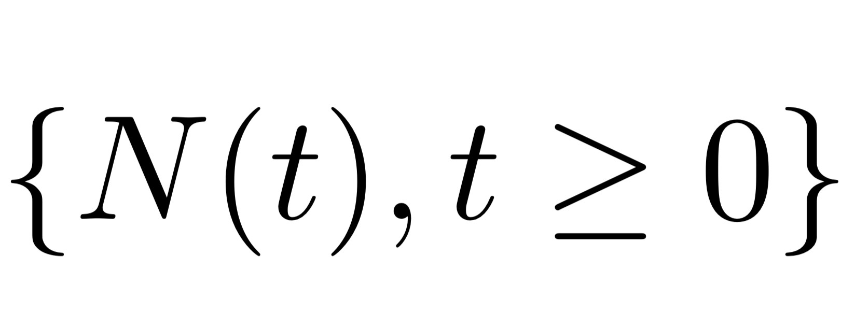
Poisson Process
-Combining the two properties we can construct a stochastic process
-Many times when we observe real-life phenomena we are tracking events happening within an interval of time, or at time t. The Poisson process can help us model events that are random and the occurrences of which are countable
--Let us first define a counting process that represents the number of occurrences at time t;

Slide 7
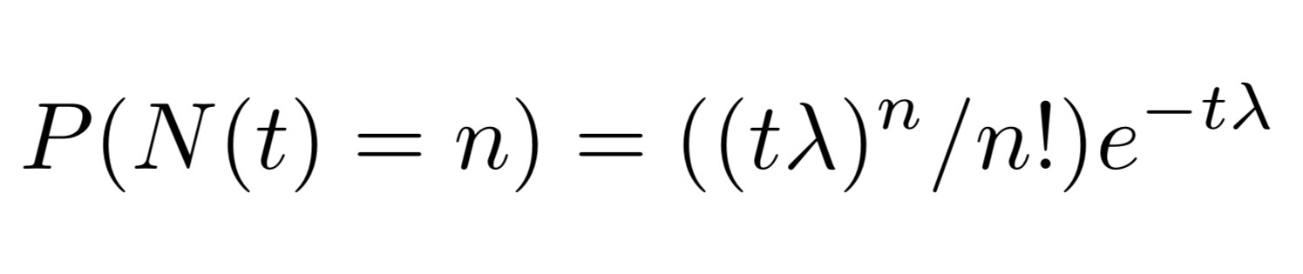
Poisson Process (cont.)
The distribution at time t would be
-The intuition is before we had no real way to calculate the number of total occurrences within time t as the Poisson Distribution has no t parameter.
-Now we can track the number of occurrences up to time t
-A good way to see this is λ is the number of occurrences per time period, and t is the actual time we are interested in. So multiplying the two we get the expected occurrences within t.

Slide 8

Complications
-The problem however is if we derive the expected value and the variance of the Poisson Process we get equal mean and variance
-We use the Fishers Index of Dispersion to quantify this:
-This is a very bold assumption to make when we consider counting data, one can see how examples in the ‘real-world’ may not follow this assumption
I(X) = Var(X)/E(X) = 1

Slide 9
Weighted Poisson Distribution
-The idea of handling under and over-dispersed data using weight functions was first proposed by Fisher, however, Rao(1965) developed a unifying methodology to apply this to various distributions
-The first instance of a weighted Poisson Distribution occurred in Castillo, J., Perez-Casany, M., (1998)

Slide 10
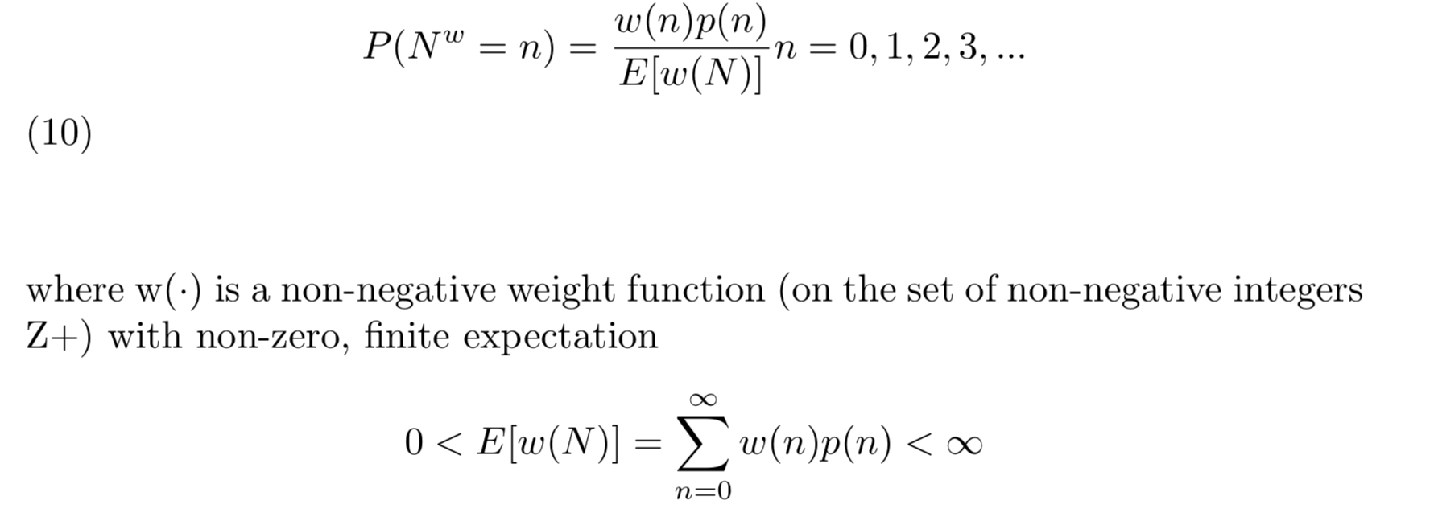
Weighted Poisson Distribution
Define p(n) as a the Poisson Distribution

Slide 11

The relationship with Dispersion
-The usefulness of this model comes from the aforementioned Fisher Index of dispersion
-As we saw before, the typical Poisson Distribution has an I(X) = 1
-Using this distribution we can construct a family of Poisson Processes that have I(X) ≠ 1
-We can even denote I(X) as the “degree of departure” from the classic Poisson Random Variable

Slide 12
The Weighted Poisson Process
-We mentioned before the importance of using these distributions to create a process that’s interpretable in terms of time t
-The problem now is turning the weighted Poisson Distribution into a full-on stochastic process
-This was the work of Bala and Kozubowski (2008)
-From the previously mentioned paper we can construct a formal methodology to turn a Weighted Poisson Distribution into a Weighted Poisson Process

Slide 13
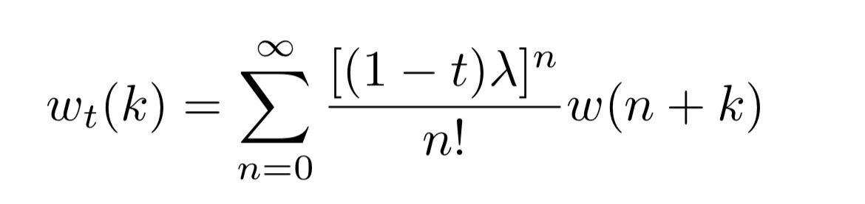
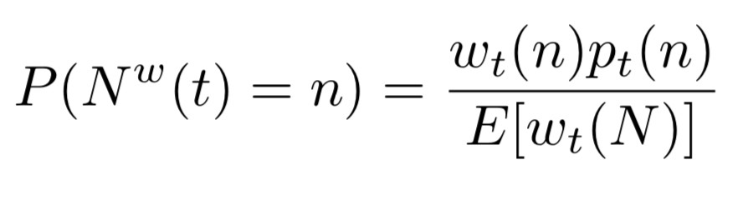
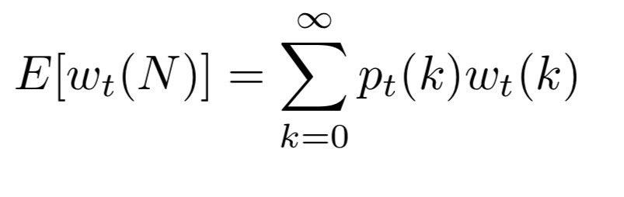
Deriving a Weighted Poisson Process
1.Propose a weight function w(n) where n=0,1,2,3,… and w(n)>0
2. The counting process N^{w}(t) has a weighted Poisson distribution with parameter and weight function:
3. We then calculate the expected value of the weight function in terms of the Poisson distribution (normalizing constant)
4.We put the above together and get:

Slide 14
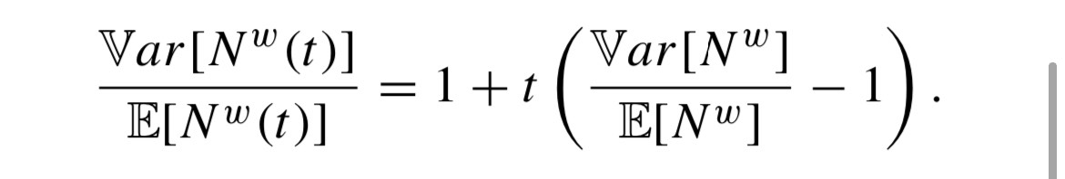
Deriving the Dispersion
-Once we derive our model it’s important to calculate the corresponding Fisher Index of Dispersion
since that’s the whole point of deriving a Weighted Poisson Process
-Luckily Bala and Kozubowski(2008) give us a useful proposition:The weighted Poisson variable N w(t) is overdispersed (respectively, equidispersed or underdispersed) for each t ∈ (0, 1] if and only if the variable N w is overdispersed (respectively, equidispersed, underdispersed)
-To get the explicit Fisher Index of Dispersion:

Slide 15
Deriving the Dispersion(cont.)
-From this, we can infer a very important property of the weighted Poisson Process
-So we can use all the relevant theorems and corollaries pertaining to the dispersion of the Weighted Poisson Distribution to derive the Dispersion of the Weighted Poisson Process
-We will soon see how this is very useful when we start deriving specific models

Slide 16
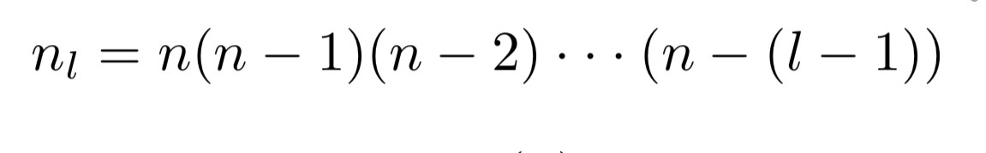
Deriving a model for w(n) = n_{(l)}
Propose a weight function of the form w(n)=n and w(n) = n(n-1)
These weight functions are specific cases of the falling factorial at l=1 and l=2

Slide 17
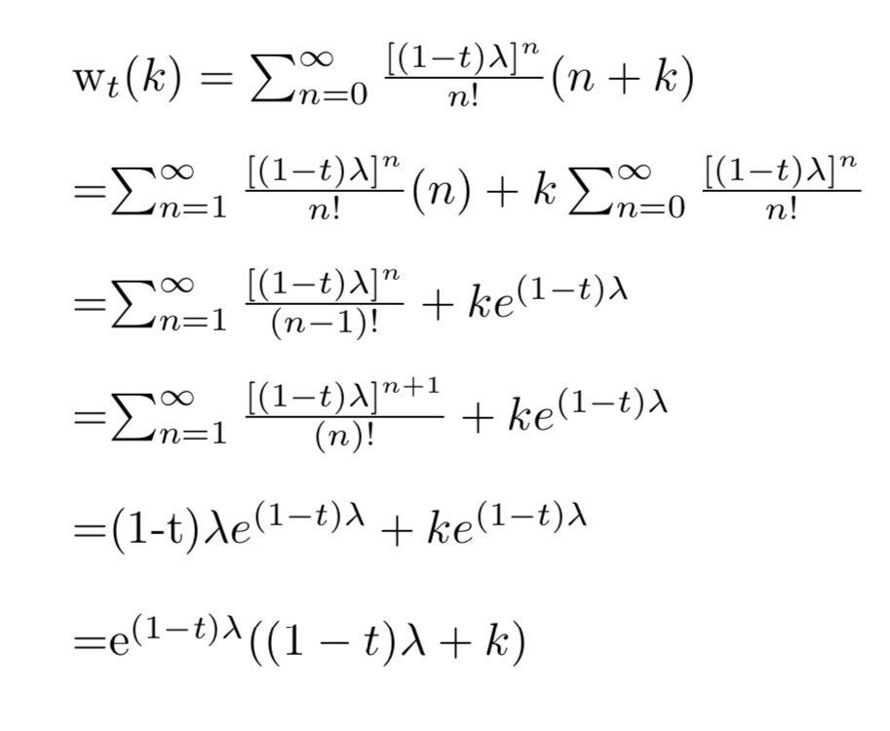
w(n) = n
-We follow the same methodology we just outlined before to get the following results:

Slide 18
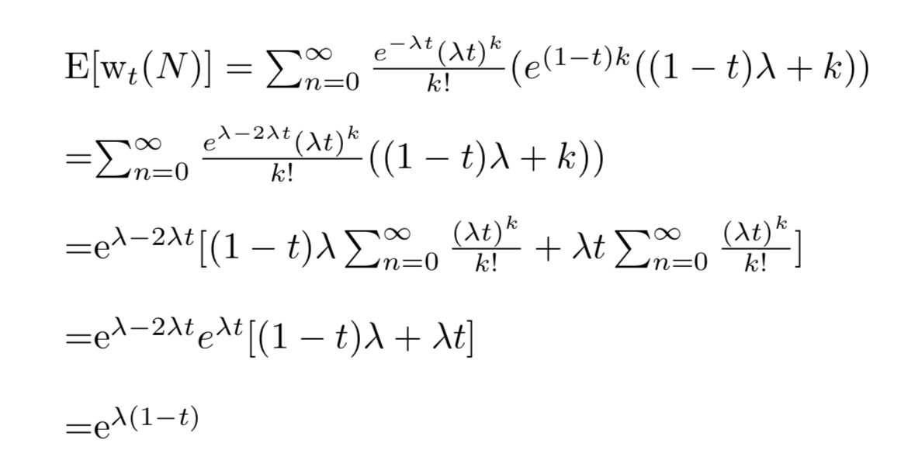
w(n)(cont.)

Slide 19
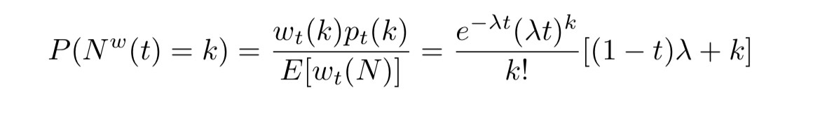
w(n)(cont.)
We get the following Weighted Poisson Process:

Slide 20
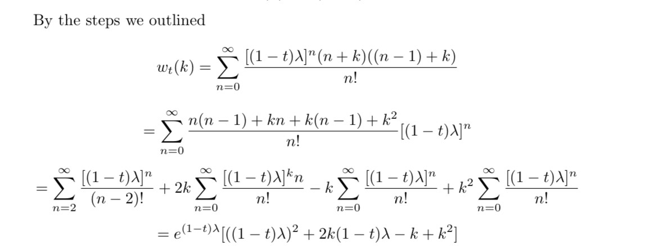
w(n) = n(n-1)

Slide 21
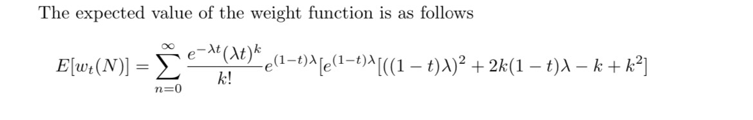
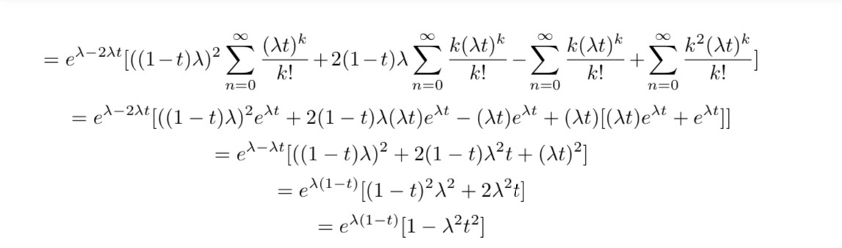
w(n) = n(n-1)

Slide 22
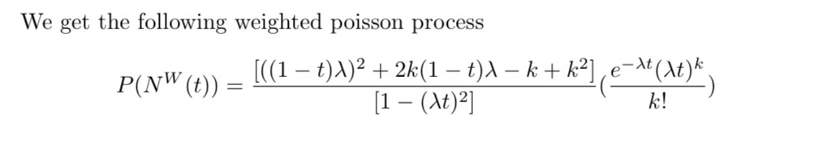
w(n) = n(n-1)
The purpose of this was to demonstrate the construction of a weighted Poisson Process
We can repeat this derivation, in the same way, to derive processes with similar weight functions n_{(l)}

Slide 23
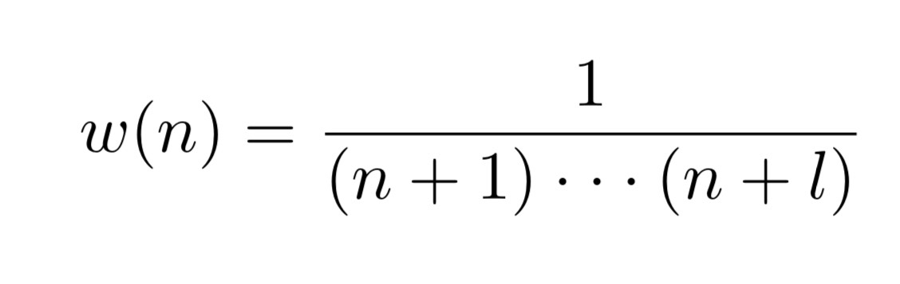
Dispersion Derivations
The important thing is what situations our model is suited for
This section of the presentation will propose the already mentioned falling factorial weight function with the hope of deriving an underdispersed model
As well as, an inverse rising factorial type weight function with the hope of deriving an overdispersed model

Slide 24
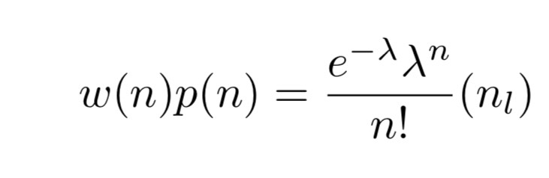
Underdispersion
-First we will prove that the Weighted Poisson Distribution (WPD) with the falling factorial is underdispersed
-We should first derive the Weighted Poisson Distribution

Slide 25
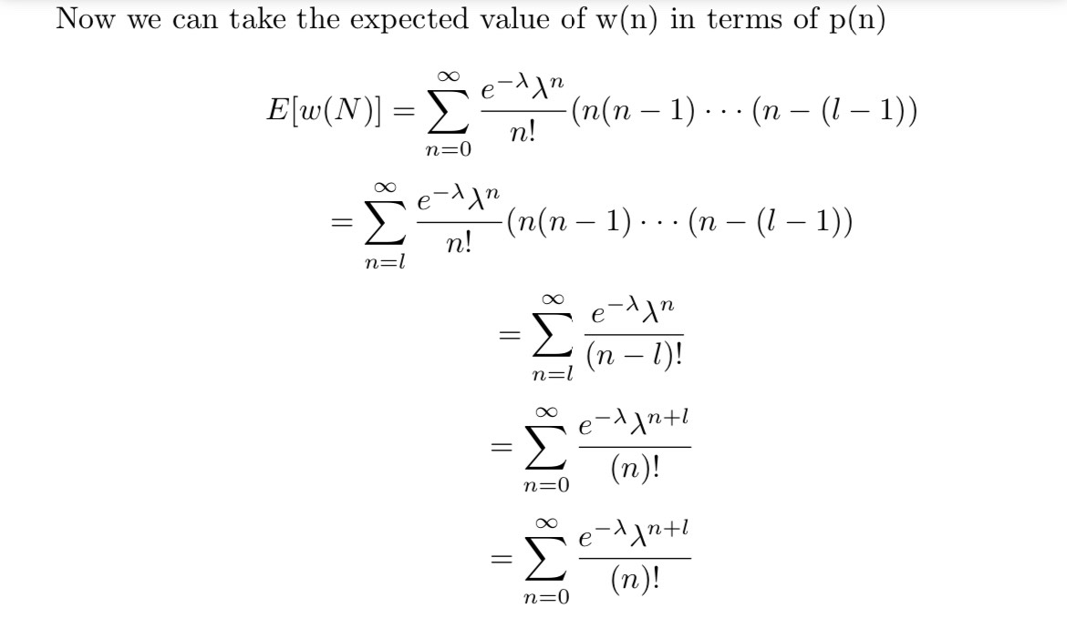
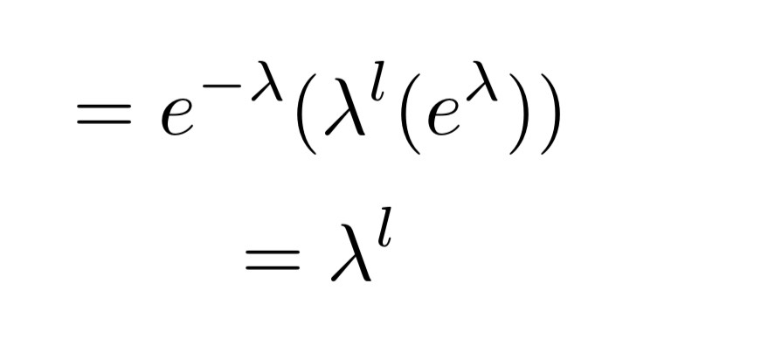

Slide 26
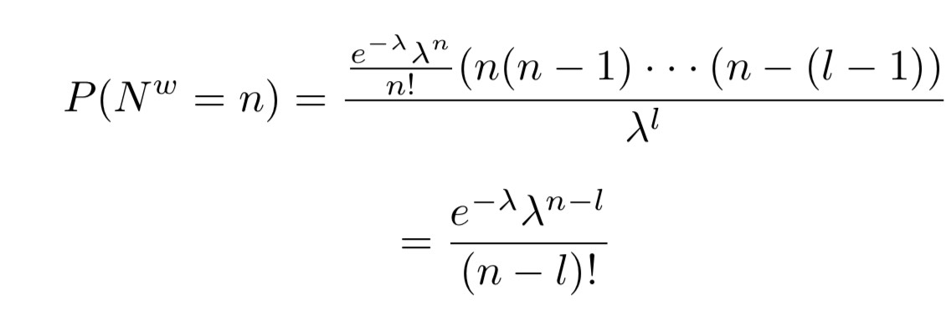

Slide 27

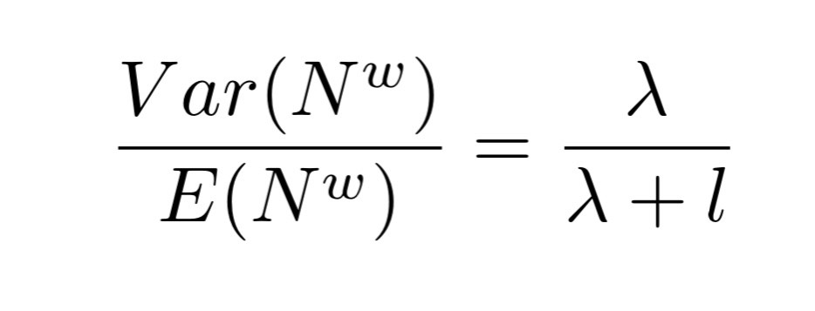
Observations
The model is simply a Poisson distribution shifted up by l
The variance is the same as the classic Poisson (λ)
the expected value is the classic Poisson value but shifted up by l (λ+l)
We get the following index of dispersion:

Slide 28
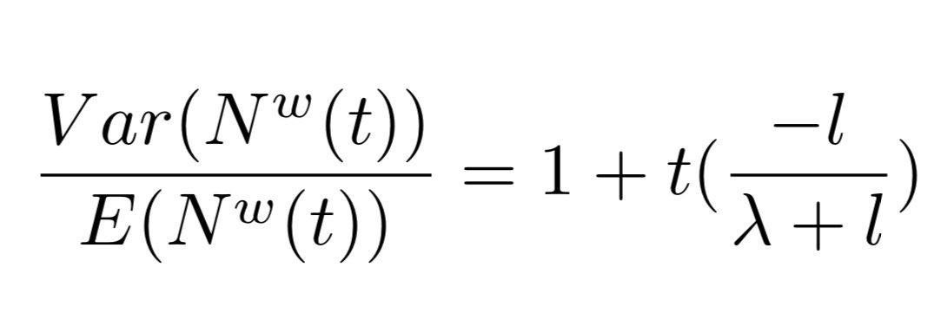
Observations (cont.)
Since l is a positive integer, the expected value is always greater then the variance
This gives us an i(N^{w}) < 1 which implies the weighted poisson distribution is underdispersed
In fact, this dispersion monotonically decreases as l increases
In this case, we can easily derive the weighted poisson process dispersion explicitly:

Slide 29
Observations (cont.)
We know that the weighted poisson distribution being underdisperesed implies the corresponding poisson process is underdispersed
Thus we have found an underdispersed weighted poisson process

Slide 30

Overdispersion
-We will now derive the dispersion for the other weight function we proposed:
-Calculating the WPD and the following dispersion will be tedious, however we can invoke a couple of useful theorems and corollaries

Slide 31
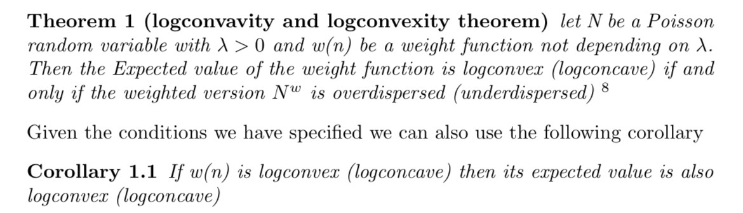
Useful Theorems and Corollaries

Slide 32
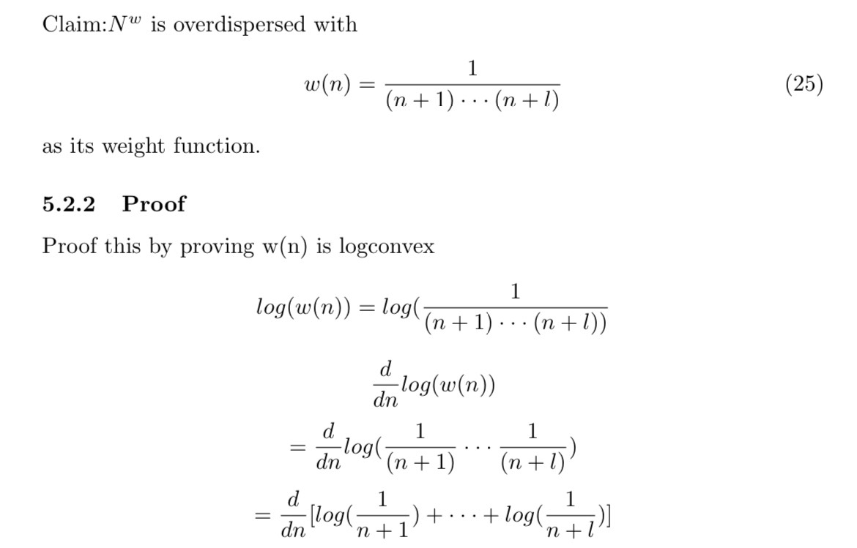
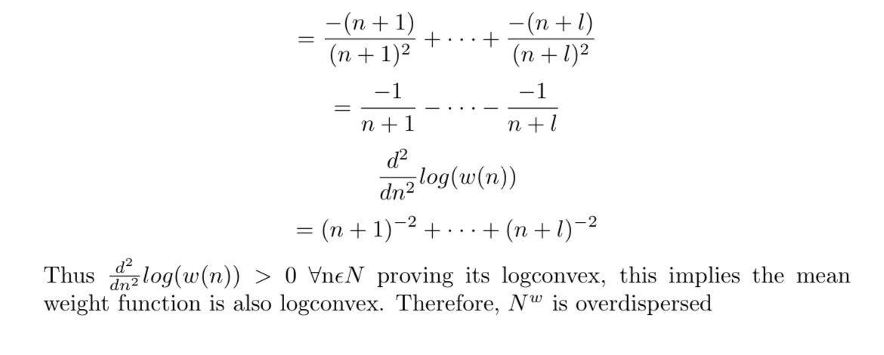

Slide 33
Conclusions
-We again, use the fact that the dispersion of the WPD is the same as the corresponding WPP
- Found an overdispersed WPP
-We will now Conduct a simulation study in python to affirm our derivations, and to visualize how the dispersion a process may look like as time increases

Slide 34
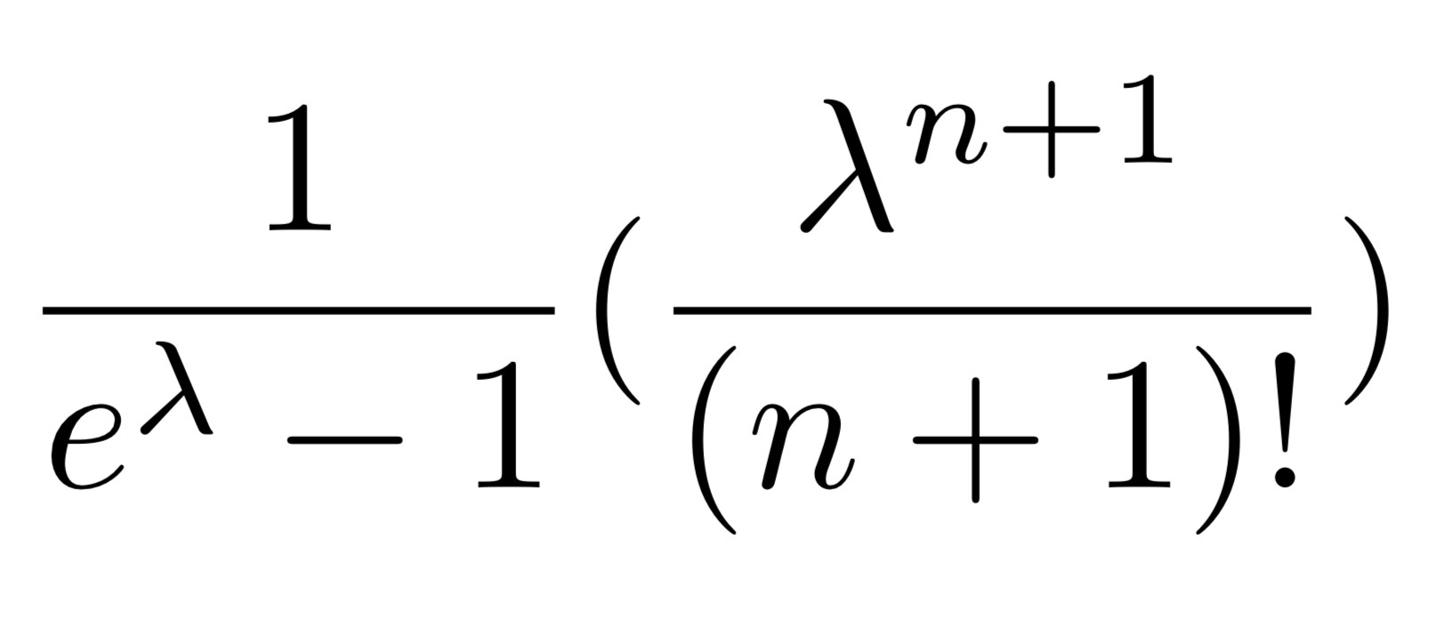
Explanation of Simulation method
To simulate the classical Poisson process we can simply use built in Poisson generators available in python (numpy)
The Falling factorial WPD is simply the classical Poisson distribution shifted up by l, in terms of coding we simply take the array generated from the classical Poisson Process and add l
For the inverse rising factorial we observe a more complicated pmf, for example when we consider w(n) = 1/(n+1) we get the following pmf:

Slide 35
Binning method
Clearly we need a more involved method for simulating this process, here we implement a 'Binning Algorithm'
The algorithm is as follows:
1.Take the pmf f(x) and create an array with f = [f(0),f(1),f(2),f(3),f(4),…..,f(100)] 100 is an arbitrary choice, we just want to capture as much of the distribution as possible
2. we then create the following array F = [f(0) , f(0)+f(1), f(0)+f(1)+f(2) ,….., f(0)+ · · · + f(100)] = [F(0),F(1),…..,F(100)]. Essentially creating a 'Bins' of the CDF
3. Then we simulate a uniform distribution to get p=(Unif-(0,1))
4. We transverse the list F until we find max{F(x)|p≤F(x)}
5.We simulate x occurences from the found F(x)

Slide 36

Python Demonstration

Slide 37
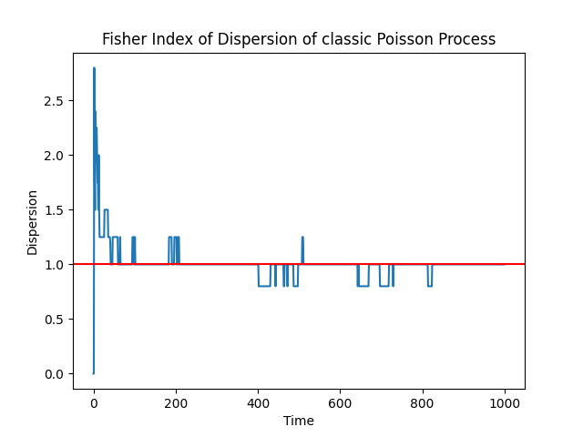

Slide 38
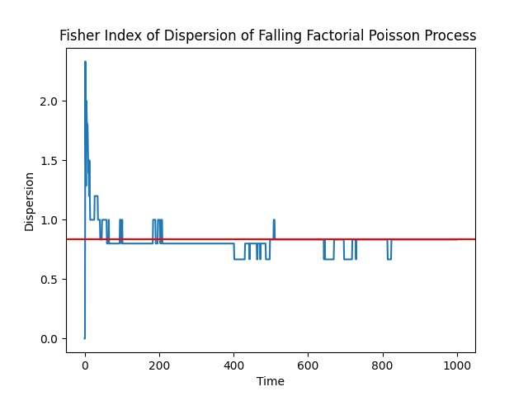

Slide 39
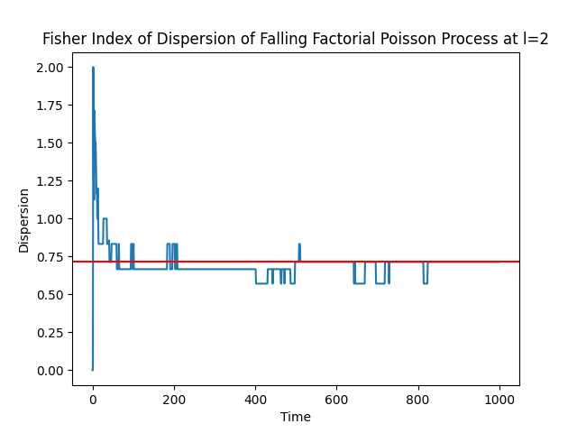

Slide 40
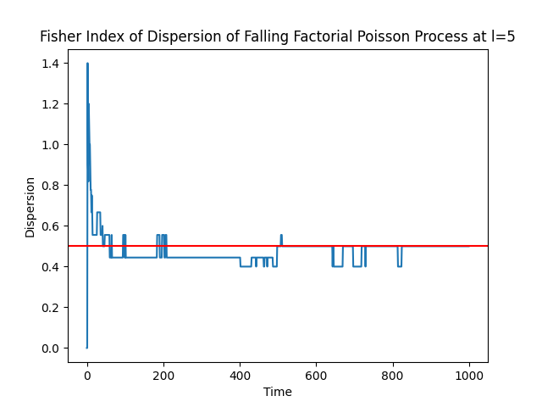

Slide 41
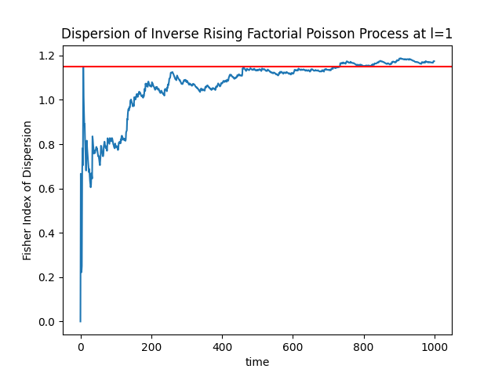

Slide 42
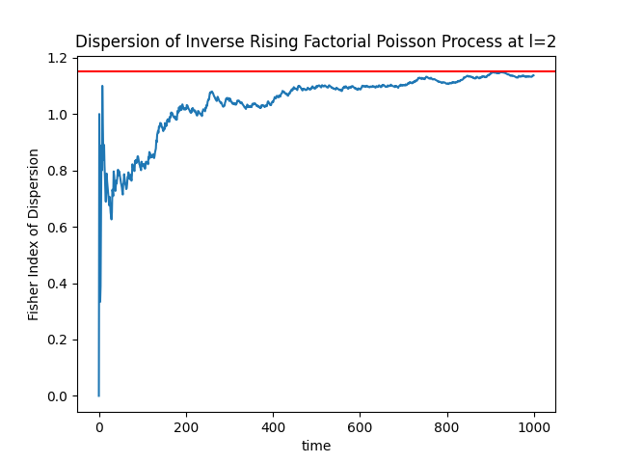

Slide 43
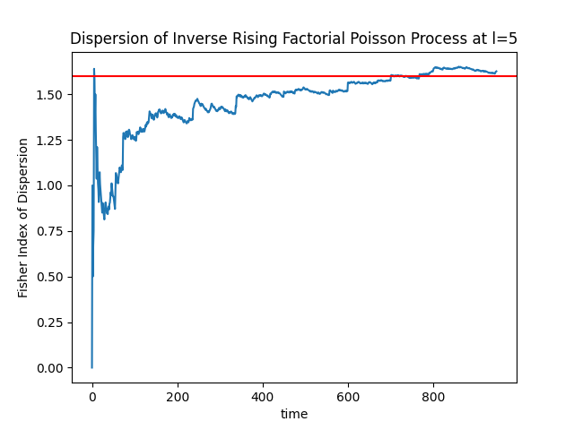

Slide 44
Conclusion
We have demonstrated how a Weighted Poisson Process can be derived and the corresponding derivations of dispersion
We also simulated our models to demonstrate the dispersion and visualize our mathematical discoveries
The result is two models are part of the weighted Poisson family, we can represent over and underdispersed data and tune our l parameter depending on the degree of over or under dispersion present in our data

